Slide 1
ENCASE:an Ensemble Clssifier for ECG Classification Using Expert Features and Deep Neural Net works

Slide 2
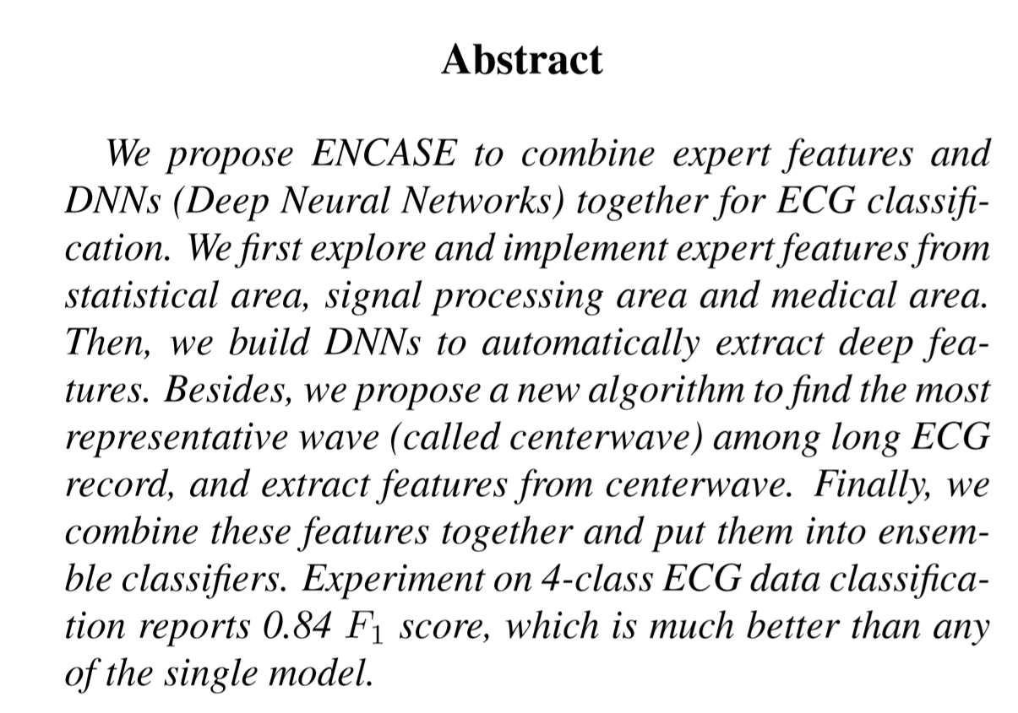
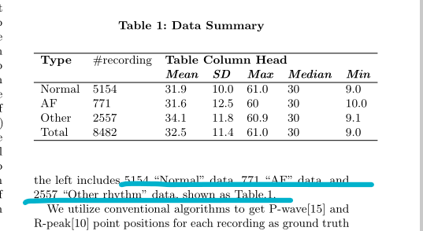

Slide 3
预处理
• Long data : We use tool from sample code to read them into numeric time series, and save raw values by records directly.
• Short data : We split the long data into short waves using QRS detector by Joachim Behar from sample code.
• QRS data : We calculate the length of consecutive QRS interval of each long data.
• Centerwave : The most representative wave among short data of each long data.
• Expanded data: Expanding to get more data using slide window and stride. In this paper, we choose window size 6000, strides are chosen dynamically for balanced dataset.

Slide 4
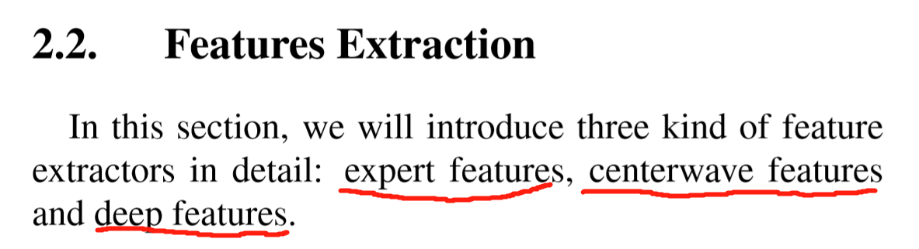
特征提取

Slide 5
Expert Features
• Statistic features: These features use statistic to summarize a sequence of ECG data, and give values that describe some characteristic of the data. Typical statistic including count, mean, maximum, minimum, range, variance, skewness, kurtosis, percentile and so on.
• Signal procession features: These features first transform ECG data from time domain into frequency domain, then extract frequency related features. For example, one may first implement FFT (Fast Fourier Transform), or DWT (Discrete Wavelet Transform). And then compute power, frequency band power, Shannon entropy, SNR (Signal Noise Ratio) and so on.
• Medical features: These features are base on medical domain knowledge. One group of features compute the variation based on QRS data. For example, [1] compute the sample entropy (SampleEn), [2] compute the coefficient of variation and density histograms (CDF), [3] compute the thresholding on the median absolute deviation (MAD), [4] compute the heart rate variability (Variability). Another group of features compute statistic based on P, Q, R, S and T waves. We follow the wave detection method described in [9], then extract statistic features from short data and centerwave like interval, duration, amplitude, location, slope and area.

Slide 6
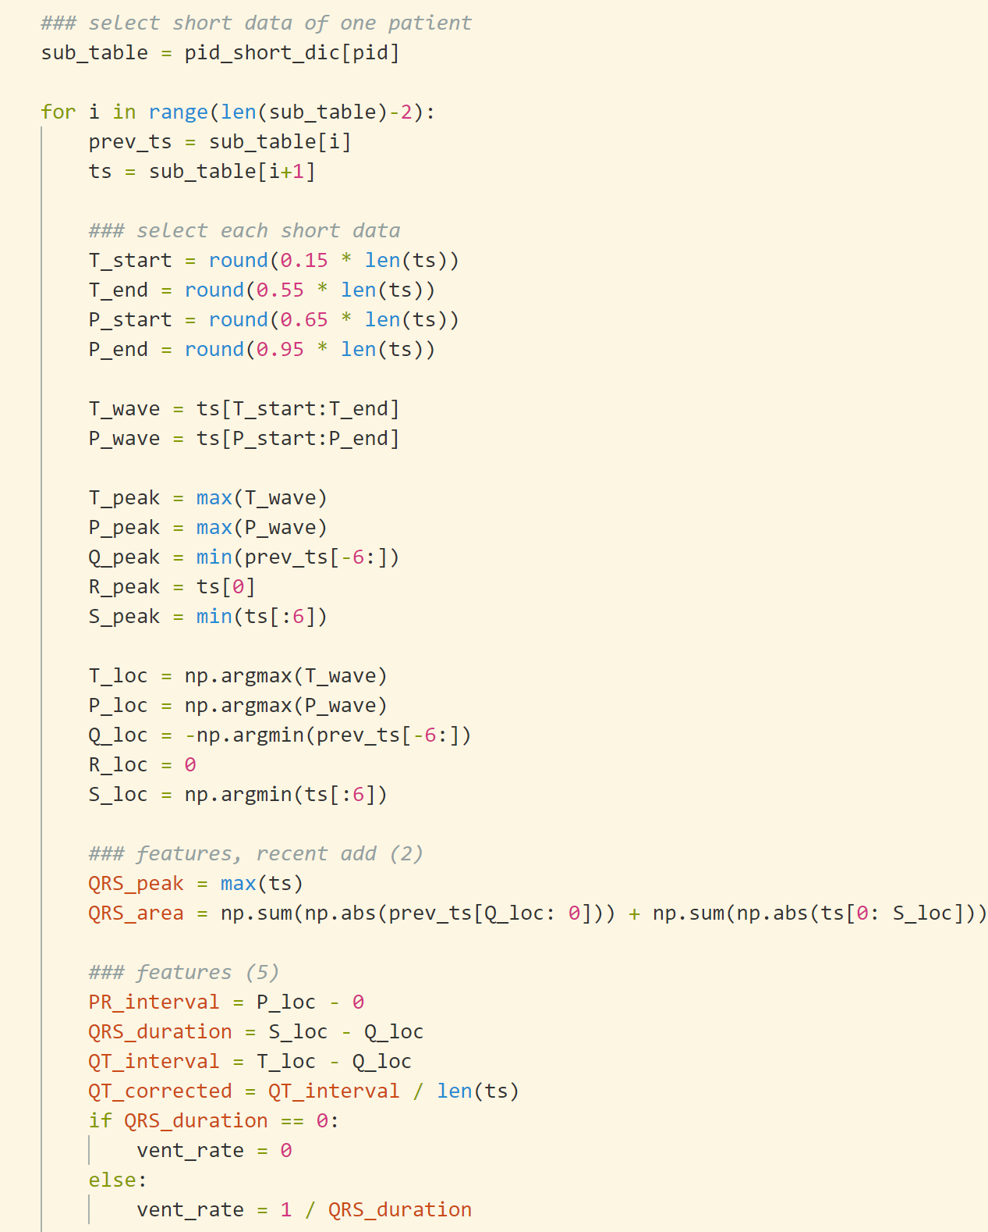
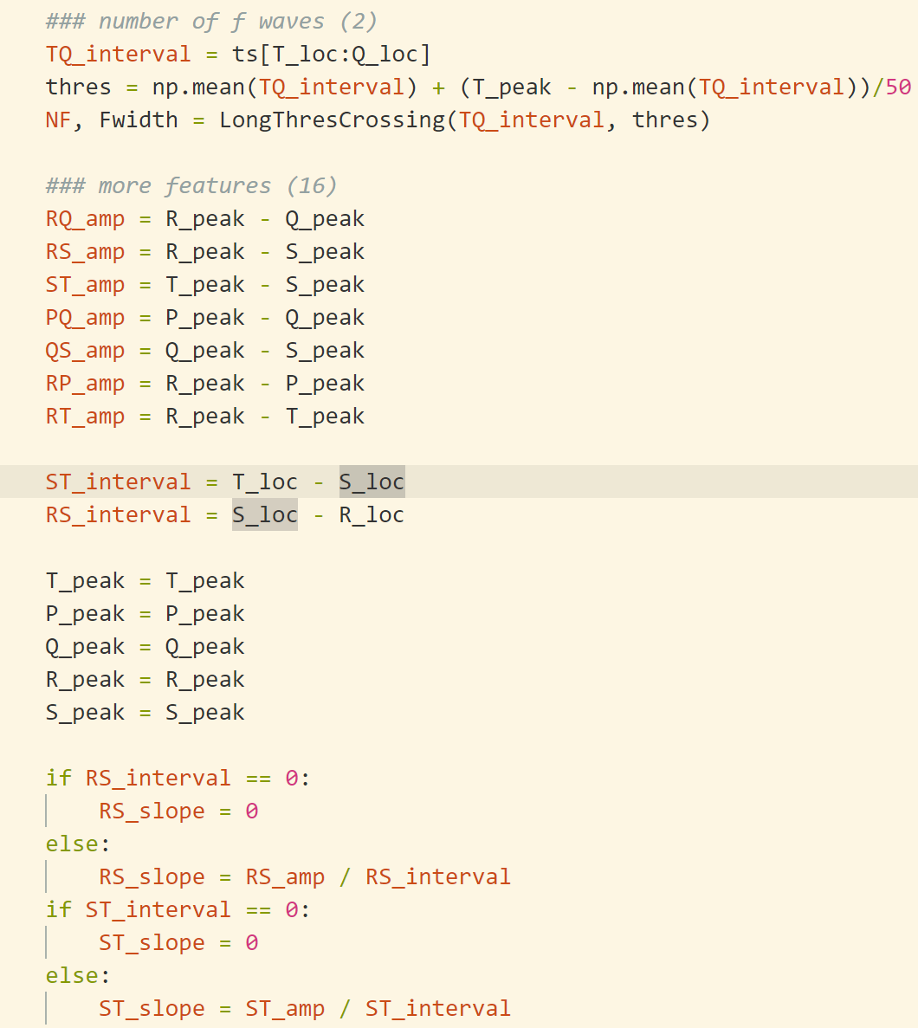
Medical Features

Slide 7
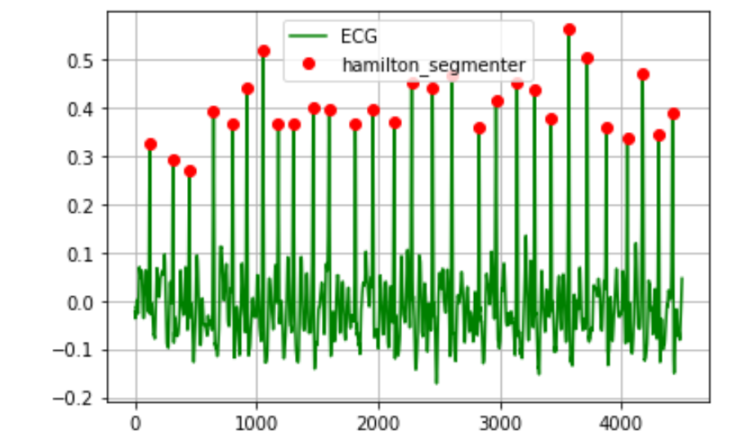
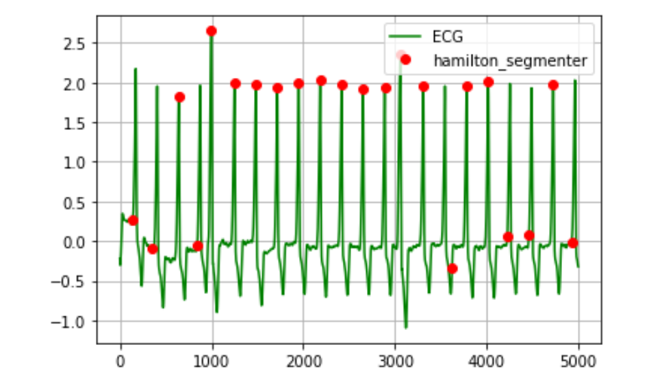
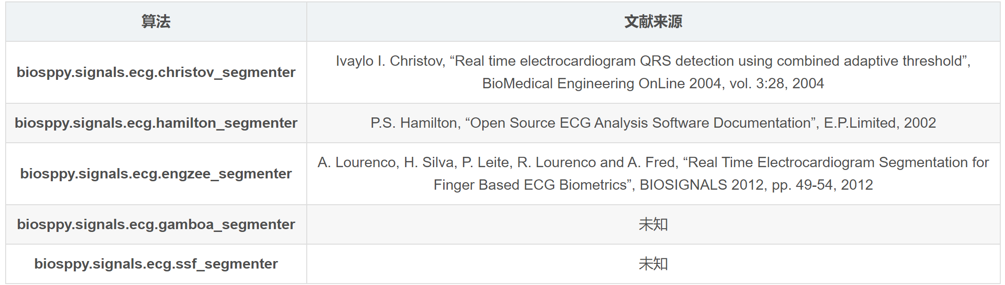
R peak detector

Slide 8
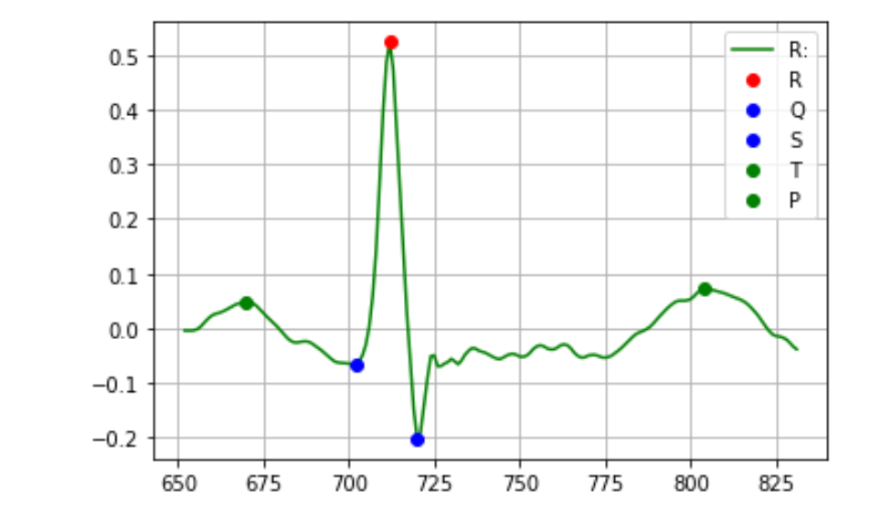
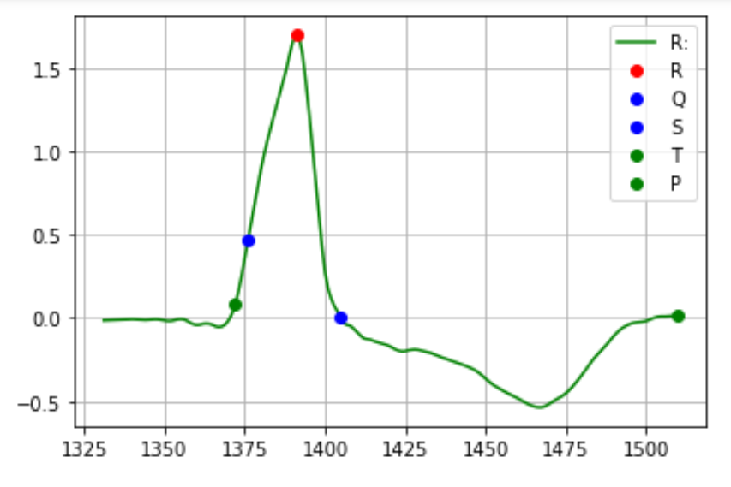
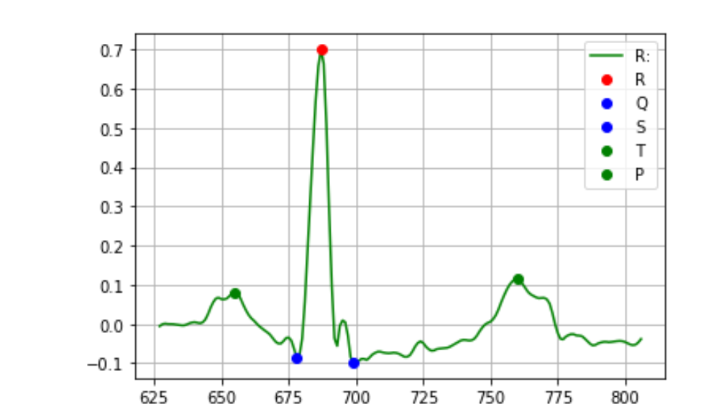
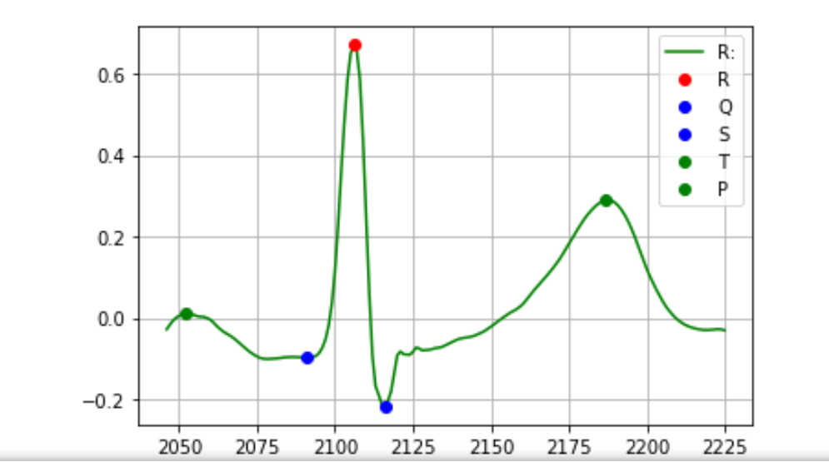
Q S T P detector

Slide 9
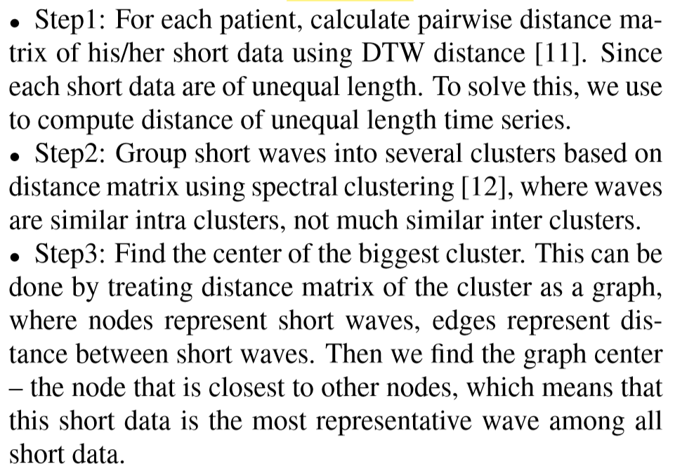
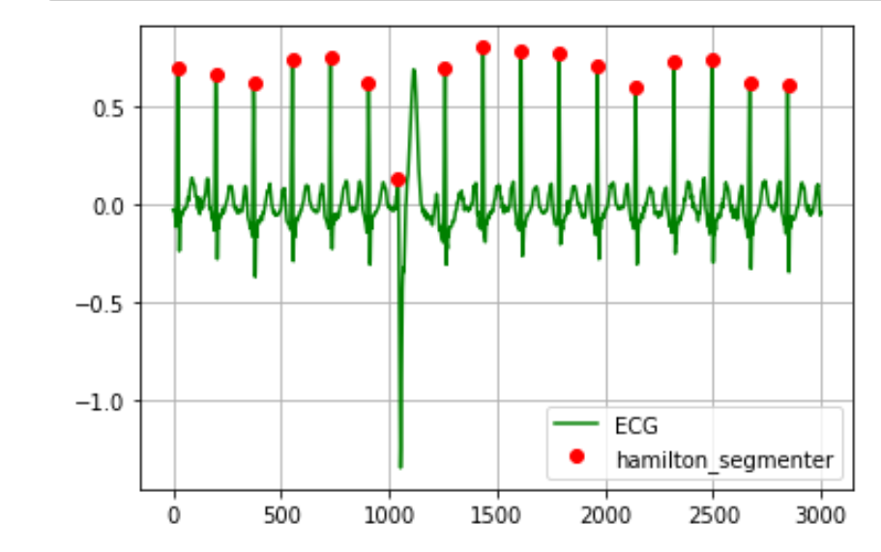
Centerwave Features
On the one hand, we observe that some of misclassified samples are contaminated by noises. Since the ECG data is not much so long, noise filters can not handle it well.
On the other hand, some classes are controlled by the morphology of the wave, not the overall rhythm. Find and analyze the representative wave directly would give better performance.

Slide 10
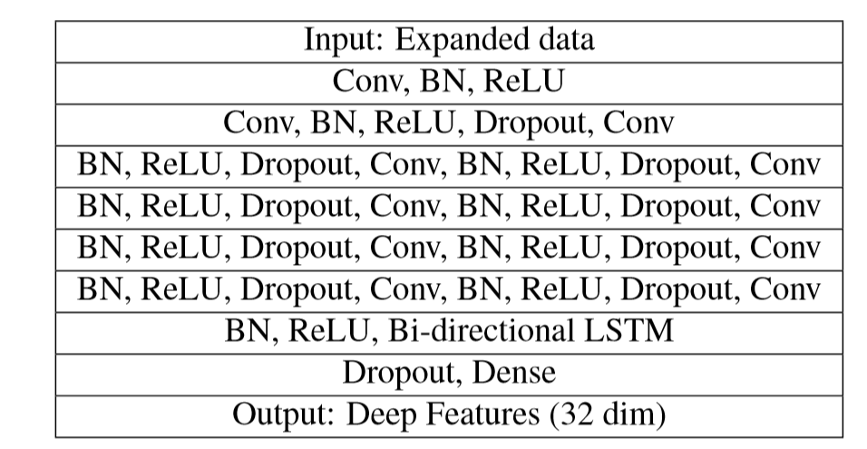
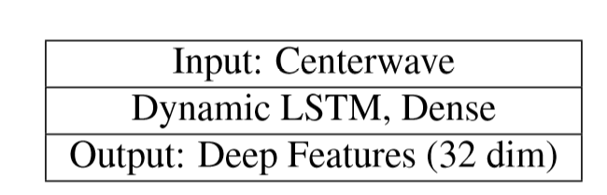
Deep Features
In detail, we remove the output layer, extract values of last hidden layer as features. This transformation is an general process that can be used in any DNNs. So we can focus on the architecture of deep feature extractors.

Slide 11
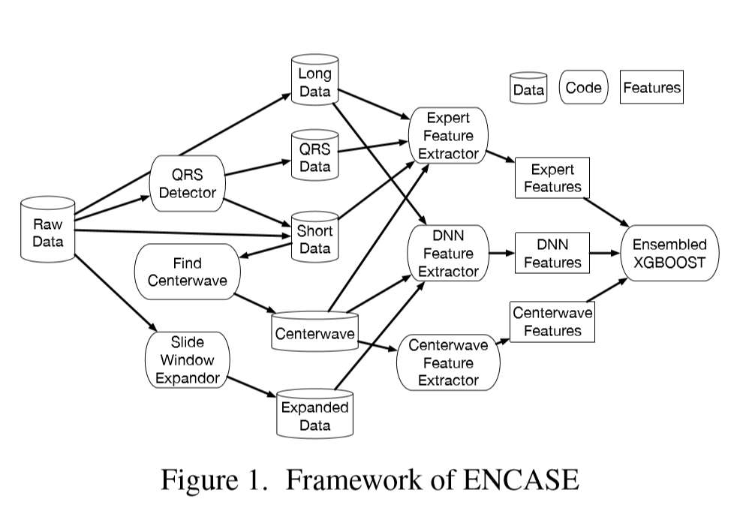
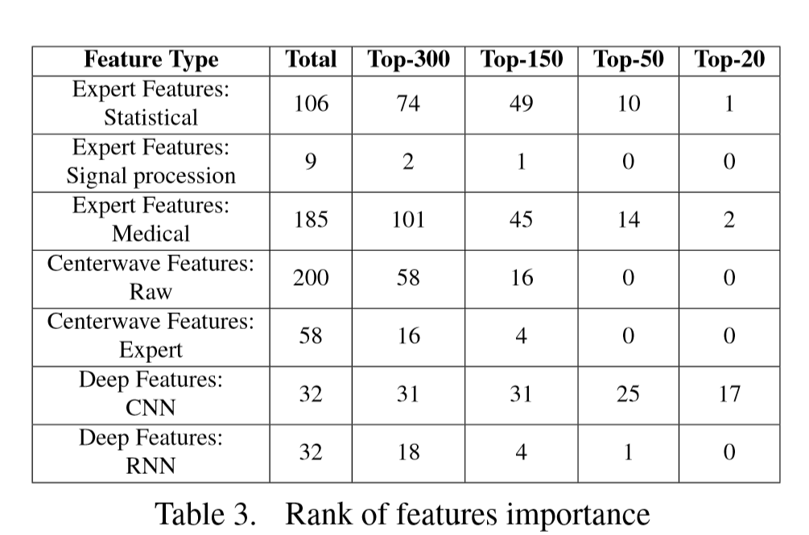
Framework & Features importance

Slide 12
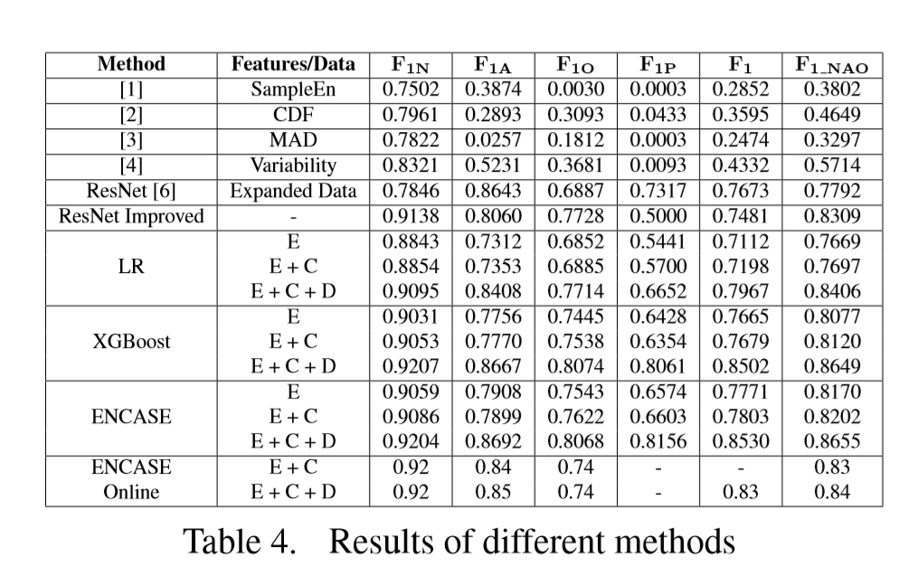
Performance
We evaluate each method by run cross validation multiple times. Results are shown in Table 4. In Features column, E stands for expert features, C stands for centerwave features, D stands for deep features.

Slide 13
Improvement
Recursive QRS detector. There are two key parameters in original QRS detector. THRES (energy threshold of the detector) and REF PERIOD (refractory period in sec betweent wo R-peaks). Theoriginal QRS detector sometimes output long sequence composed of several undivided QRS. To handle this, we multiply THRES and REF PERIOD by factor of 0.68, each time the algorithm output segment longer than 600 (twice of sample frequency), and apply new QRS detector on the undivided long sequence.
Dynamic oversample. The given raw data is unbalanced that label N is much more than other labels. We propose dynamic oversample to handle this. Specifically, when generating expanded data for deep feature extractor, we use small stride for label O and big stride for label N. So that the modified expanded data are much more balanced than raw data. The modified expanded data would train a better deep feature extractor.
Model evaluation and selection. The typical offine evaluation schema is to split the data in to training data and testing data, build the model on training data and evaluate on testing data. For more accurate evaluation of ENCASE, we use k-fold cross validation to split the data iteratively, and run cross validation multiple times. The final average F1 score would be more credible. We build multiple ENCASE models with different setups to choose the best model. The final ENCASE ensemble five XGBoost, and each XGBoost has 3000 trees with max depth = 9, minchild weight = 3.

Slide 14
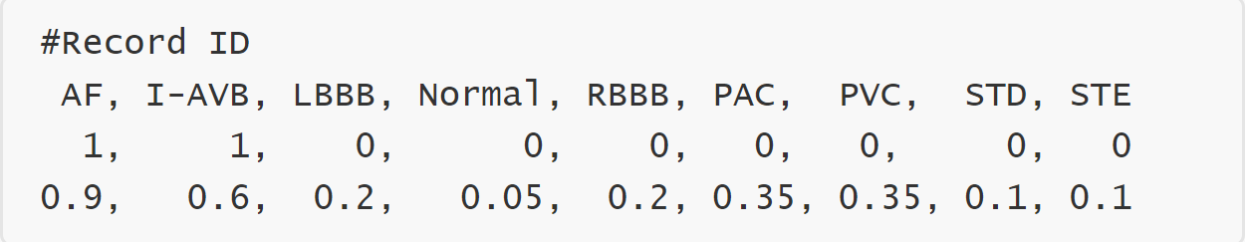
One VS Rest

Slide 15
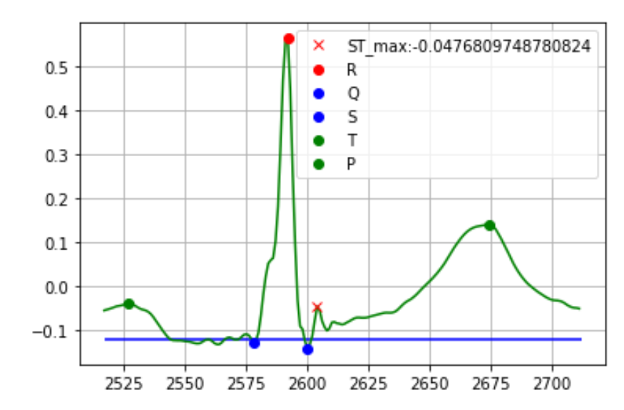
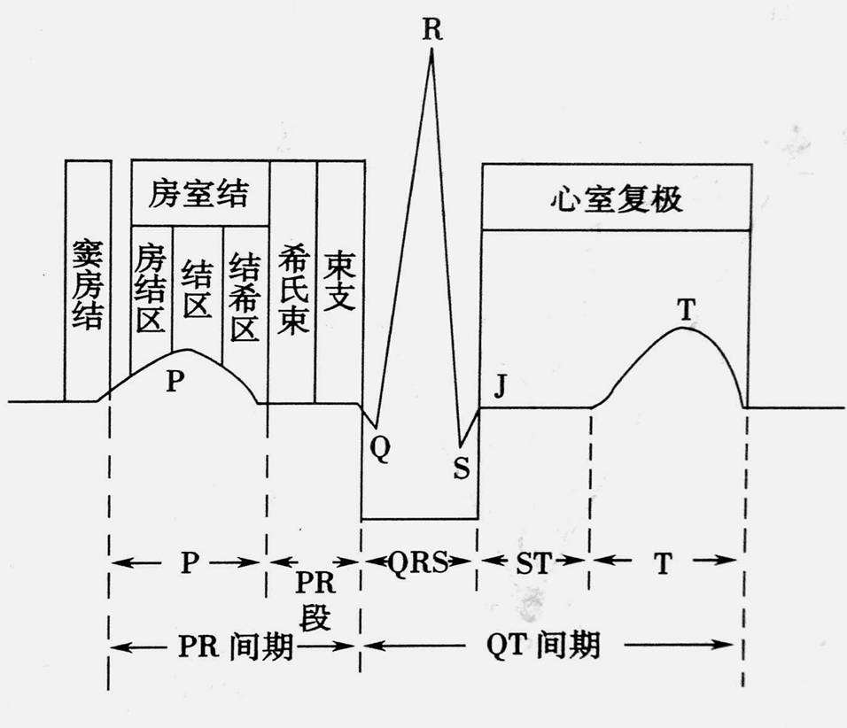
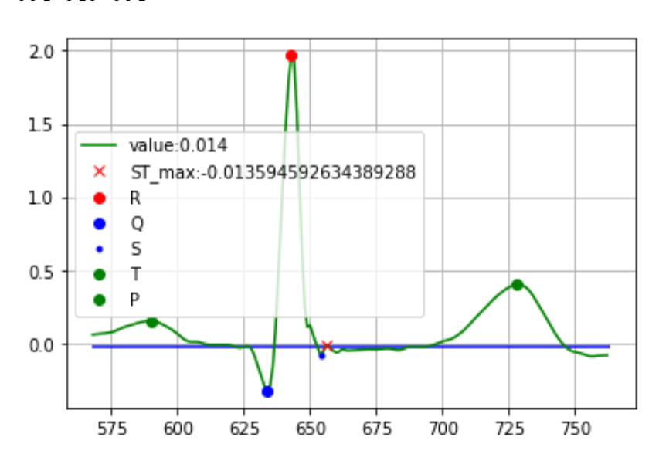
Features for STE
PR段作为基线，与ST的最大值的差，若III导联中大于0.1mv，v2,v3导联中大于0.15mv，其他导联中大于0.05mv，则判定为STE

